Slide 1



WV High Altitude Balloon Mission Team Meeting 01/26/2023
WV Space Grant Consortium (WVSGC)
Trinity Christian School (TCS)

Slide 2
Overview
Mission Overview
Team
Mission Goals
Mission Concept
Team Responsibilities
Opportunities to Participate
Use of Github
Actions
Schedule
Risks
Launch Locations

Slide 3
WV High Altitude Mission – Part of NEBP
WVSGC and TCS was selected as 1 of the 70 teams building, launching, operating, and recovering high altitude balloons
Mission Launch
Annular Eclipse - October 14, 2023
Total Solar Eclipse - April 8, 2024
= Launch Sites
Overarching Goal: Design, develop, test, deploy, and recover stratospheric ballooning systems.
The team will fly large balloon platform capable of lifting 12 pounds of student-designed and built payloads to 80,000 – 100,000 feet, streaming live video and collecting critical data along the way.
Typical engineering platform experiments include atmospheric measurements, photography, cosmic radiation measurements, and space technology proof-of-concept hardware.

Slide 4
Current Team Members

Slide 5
WV NEBP: Mission Concept and Activities
Develop High Altitude Balloon Systems and Ground Stations that provide real-time video of solar eclipses to NASA websites (see next slide)
Conduct monthly lunch and learns broadcasted across state
Conduct state-wide challenge for WV’s mission logo
Conduct state-wide initiative to have public submit their names to fly on board
Conduct outreach across the state regarding HAB and eclipse science
Develop High School engineering class in cybersecurity and HAB
Develop University class in systems engineering with HAB as project
Develop System model and software-only simulation of HAB system
Recruit schools across WV to participate:
Participation can be in various ways (i.e., outreach, data analysis, payload development)

Slide 6
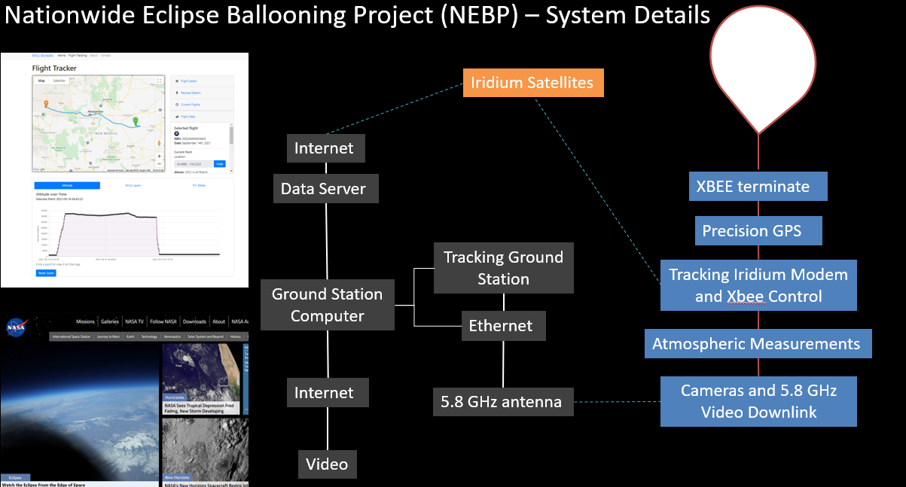
High Altitude Balloon (HAB) System - Concept
Parachute

Slide 7
Current Responsibilities
HAB System
WVUSGC
TCS
WVU ARC
Balloon
Parachute
xBee cut away
GPS
Tracking Modem
Camera & 5.8 GHz Video Downlink
Ground System
NASA Data Server
Tracking Station & 5.8 GHz Antenna
Ground Station
Atmospheric Measurement
Payload A
Payload B
TCS
?
Initiative Leads
Project Management (WVSGC and TCS)
State-wide mission logo (Glenville State)
State-wide submitting names (Glenville State)
Outreach across state in HAB and Science (Glenville State)
Monthly Lunch & Learns (TCS)
Mission Web Site & Blogging (WVSGC)
Summer Workshop (WVSGC & TCS)
High School Class Development (TCS)
University Class Development (WVU)
System Model
FlatSat
Software Only Simulation
TCS

Slide 8
Opportunities To Participate:
October 2023 Eclipse Flight
One Payload Spot
Second flight system may fly – 6 possible payload opportunities
April 2024 Eclipse Flight
One Payload Spot
Second flight system – 6 payload opportunities
Initiatives:
Offer High School class in computer engineering 2023-2024 academic year
Electronics, Arduino, Linux, Raspberry Pi, Pi and Electronics - Material will be provided along with some hardware
Summer Workshop at Trinity Christian School (June 26-30, 2023)
Explore Amazon Ground Services to investigate its use as a ground station
Conduct outreach across the state (e.g., Balloon projects, parachute projects, Arduinos, etc.)
Data Analysis on post flight data (e.g., data sciences class and/or machine learning class)
Design Mission Logo
Payload Ideas:
Basic weather station package (e.g., middle school team)
Artificial Intelligence (AI) generated code
Image processing investigations and AI/ML
Quantum Experiment
Near Infrared Camera
Glider that returns to launch site
Long duration flight
Electron Density

Slide 9
Use of GitHub
We are utilizing GitHub to manage the development of artifacts as well as manage our actions
GitHub represents everything as an “Issue”
Use a Kanban board or a dashboard to display status
https://github.com/profFisher/NEBP_WV
Walk Through GitHub
Actions on everyone (e.g. checklist)
Medical & Media release form
Student and Mentor Surveys
Going through lessons (15 lessons)
Do we need a Team forum to chat (e.g., discord server)?
Team members need to login to GitHub, everyone is a collaborator

Slide 10
Current Schedule

Slide 11
Risks
Brainstorm

Slide 12
Launch Locations

Slide 13
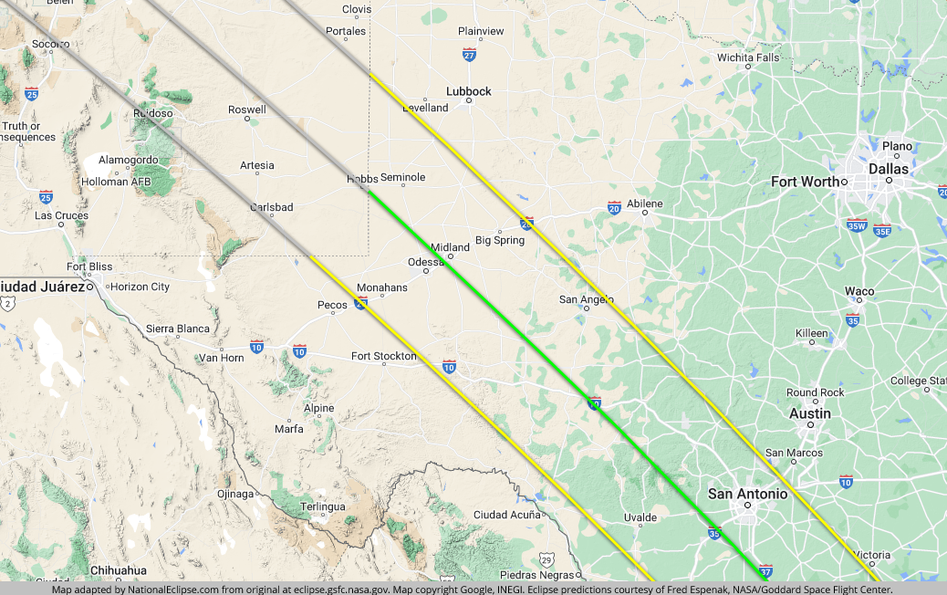
October 2023 Launch Site

Slide 14
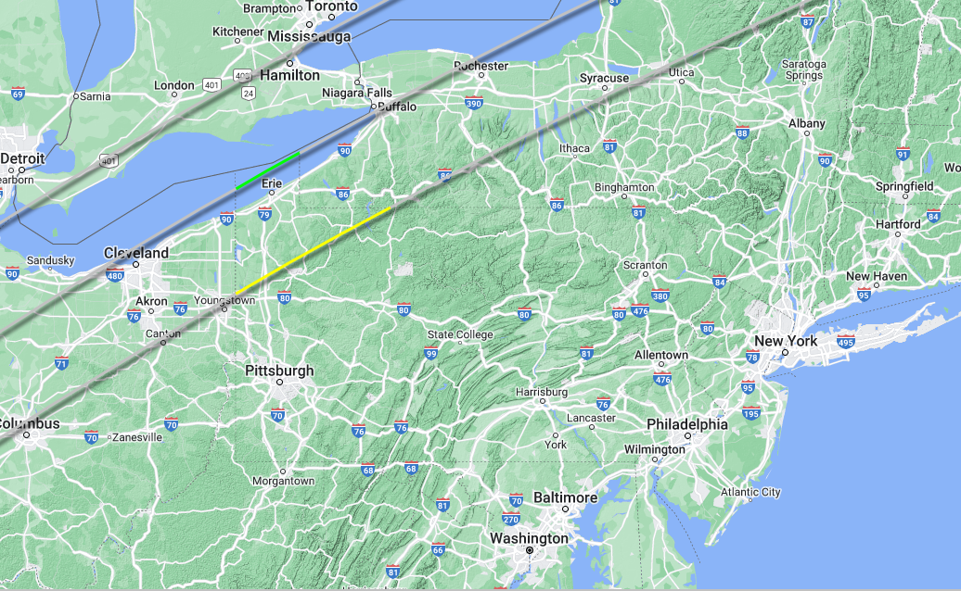
Potential April 2024 Launch Site

Slide 15
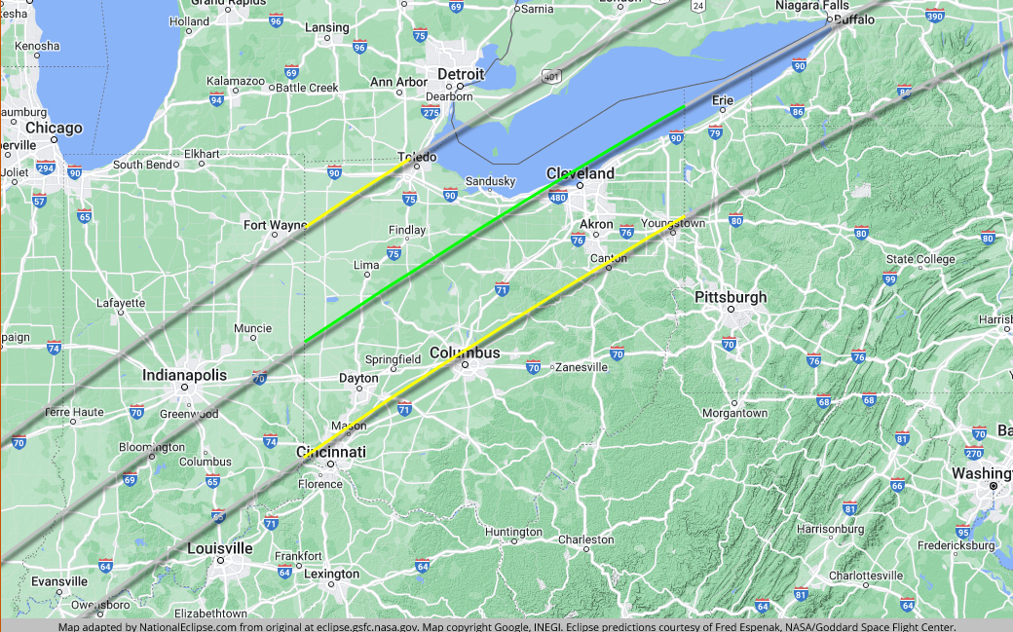
Potential April 2024 Launch Site

